Slide 1
Time Series based Electricity Price Forecasting with Artificial Neural Networks: Methodology, Benchmarking and Coding
How important decisions about the approach, IT architecture, tools and methods can be made in order to successfully carry out a data science project
Illustrate the interaction of data, methods and tools for analysis and visualization
Dr. Michael Thrun

Slide 2
What the talk is going to be about…
Only a „bird‘s-eye view“ is possible in the given time
Requires several simplifications
All required code will be shown but remains largely unexplained
-> Please look into the documented source code as „homework“

Slide 3
Learning targets
Success factors for data science are understood
Challenges in forecasting are known based on ML theory
Benchmarking in Forecasting can be performed (on the example of electricity price forecasting )
You will be able to spot the pitfalls of my live coding in forecasting
(Using the concepts presented)
(Without the necessity to understand the details of the code)

Slide 4
What is the most important Skills for a Data Scientist?
Programming (e.g. Python/R)?
Mathematics or Statistics or Machine Learning?
Technology Stack?
Acquaintance with Data Science Tools (e.g. Tableau, Pandas/Scikit-learn, Databricks)?
Big Data Technologies (e.g Spark)?
Data Wrangling?
Soft-Skills? (e.g. Communication skills, social intelligence, people skills)?
Software-Engineering

Slide 5
Relevance of Skills in Data Science
Communication, especially with “domain expert”
Intuition about Data (Experience)
Data Wrangling
Statistics
Machine Learning
Programming
Visualization
Software Engineering
Big Data
80 % of work is preprocessing:
Data wrangling (i.e. generating structured data set
Redefining the objective until it fits the request
Then, Restarting preprocessing after talking to the domain expert
More preprocessing ☺
15% is applying statistics and machine learning
5% finding understandable visualization/Presenting the results

Slide 6

Perspectives of a Data Science Project
How you’ll feel as Data Scientist
Overall objective:
Generate new turnover with smart services
Lower costs with automation and insights
Support Decisions through advanced analytics/ML/AI
Process Steps:
Ambition
Request & Potential
Embedding
Applying results
Data
Availability & Quality
Source: systemkameraforum.de
⇒ 300+ PS on a dirt road
Analytics

Slide 7
Roles in Data Science
Solution Architect and Domain Expert
Deep knowledge in the data sources of the company/research field
Contact points for analytic requests
Translator of domain specific issues to data science objectives (interdisciplinary)
Data Scientist
Translator of to data science to domain specific objectives (interdisciplinary)
Deep knowledge in Machine Learning and Statistics
Performs proof-of-concepts and builds prototypes
Develops models for insights and automated decisions
Data Engineer
Deep knowledge in IT architecture
Extracts Data from Source (e.g. IoT, database,…)
Embedding, i.e. Builds the minimal viable product from the prototype

Slide 8
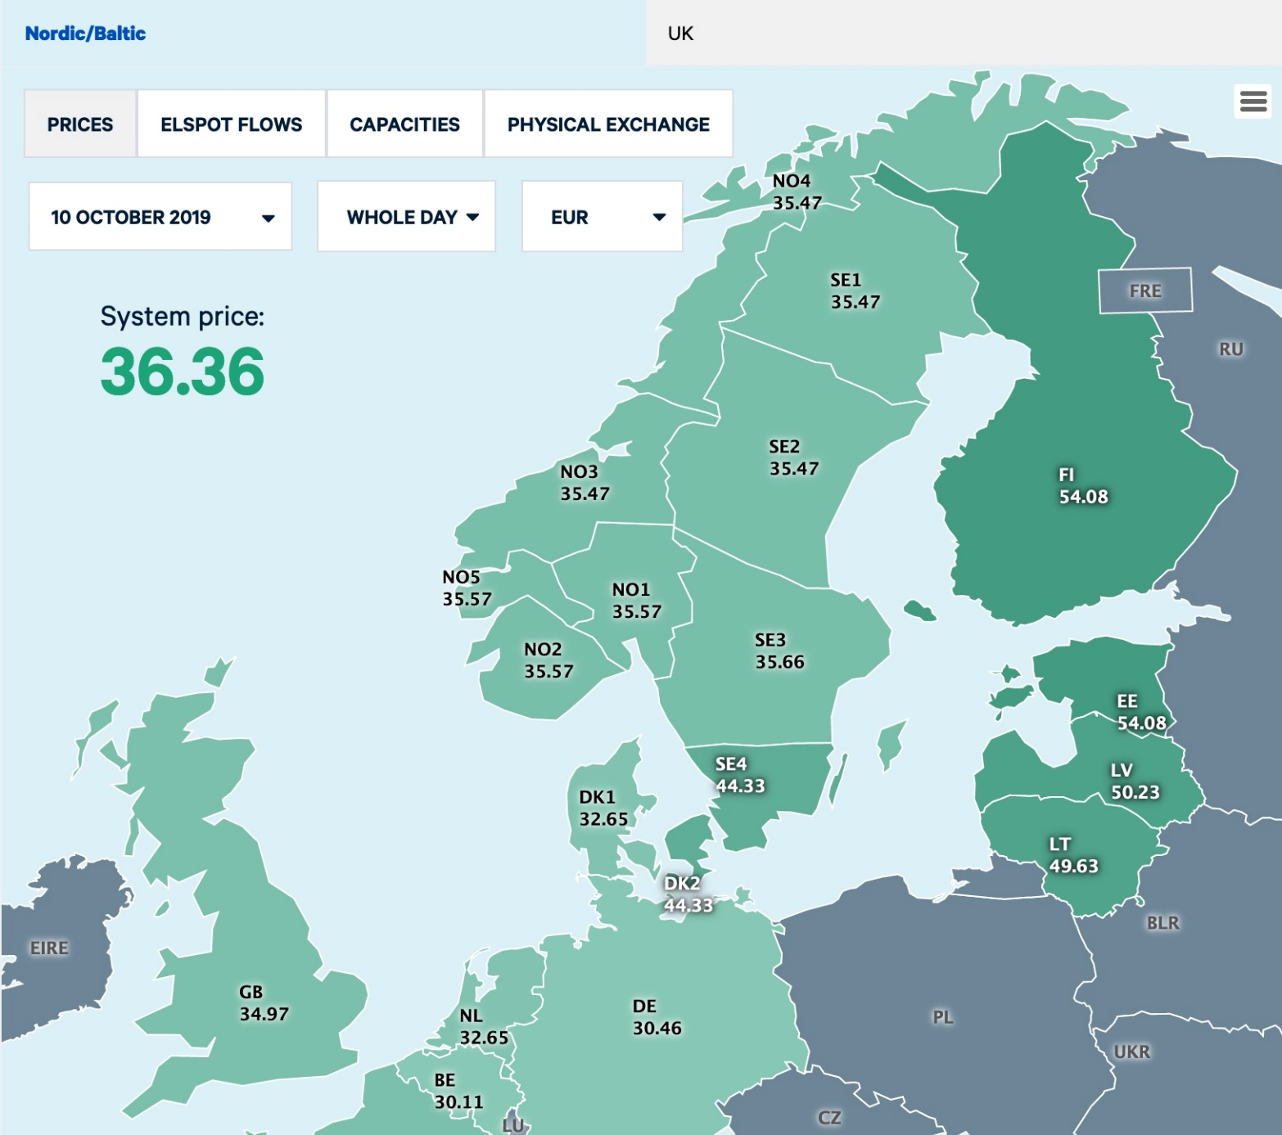
Dataset
https://www.nordpoolgroup.com/historical-market-data/
7 years of data in hourly resolution
Regions SE1;SE2;SE3;SE4;FI;DK1;DK2;Oslo;Kr.sand;Bergen;Molde;Tr.heim;Tromse;EE;LV;LT
Sys: system price for each hour is based on the intersection of the aggregated supply and demand curves representing all bids and offers in the entire Nordic market
-> Target feature

Slide 9
Typical Starting Point
Communication with Domain expert is the key for success!

Slide 10
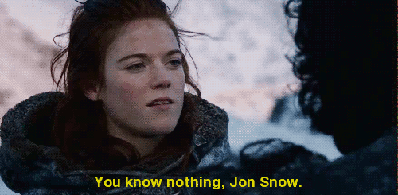
Typical Starting Point
Communication with Domain expert is the key for success!
Always assume:
-> On the example of Electricity Price Forecasting I will outline why

Slide 11
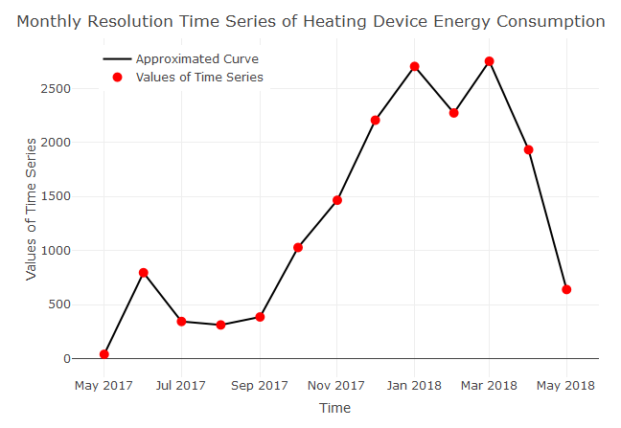
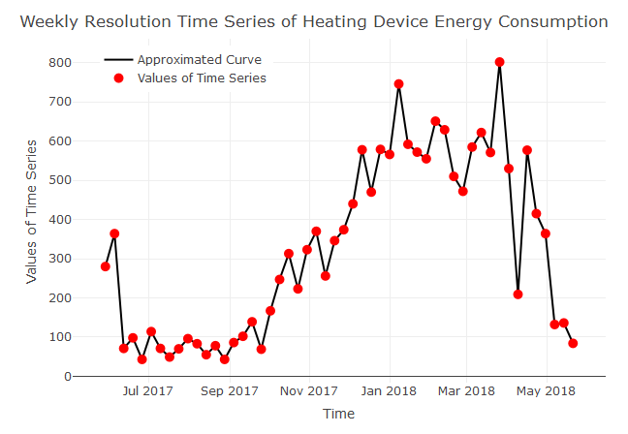
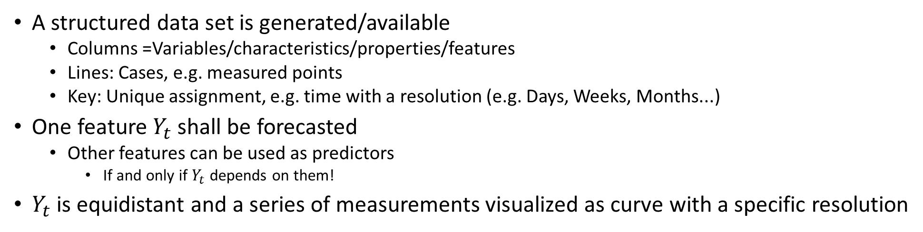
Recapitulation: Basic Definitions
A structured data set is generated/available
Columns =Variables/characteristics/properties/features
Lines: Cases, e.g. measured points
Key: Unique assignment, e.g. time with a resolution (e.g. Days, Weeks, Months...)
One feature $Y_{t}$ shall be forecasted
Other features can be used as predictors
If and only if $Y_{t}$ depends on them!
$Y_{t}$ is equidistant and a series of measurements visualized as curve with a specific resolution

Slide 12
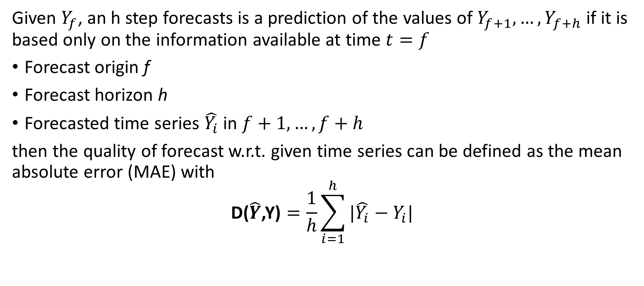
Recapitulation: Forecasting
Given $Y_{f}$, an h step forecasts is a prediction of the values of $Y_{f+1},{…,Y}_{f+h}$ if it is based only on the information available at time $t=f$
Forecast origin f
Forecast horizon h
Forecasted time series $\hat{Y_{i}}$ in $f+1,…,f+h$
then the quality of forecast w.r.t. given time series can be defined as the mean absolute error (MAE) with
$$\text{D}\text{(}\hat{Y}\text{,}\text{Y}\text{)}=\frac{1}{h}\sum_{i=1}^{h}{|\hat{Y_{i}}−Y_{i}| }$$

Slide 13
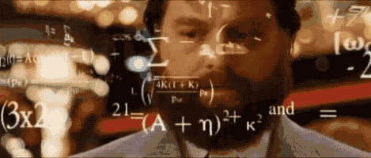
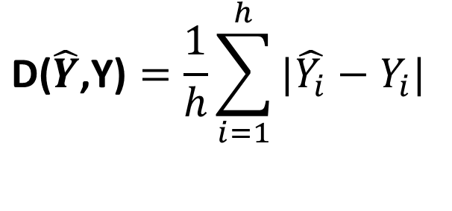
Optimizing Mean Absolute Error (MAE)?
$$\text{D}\text{(}\hat{Y}\text{,}\text{Y}\text{)}=\frac{1}{h}\sum_{i=1}^{h}{|\hat{Y_{i}}−Y_{i}| }$$
=> Minimizing the error D maximizes the forecast quality?
Can we perform forecasts for every problem using standard optimization techniques?

Slide 14

Outlining the Pitfall and Challenges using ML Theory
No, but a lot of people thought so in various examples illustrated by [Silver, 2012] ☺

Slide 15
Outlining the Pitfall and Challenges using ML Theory
Ugly Duckling Theorem (UDT) [Watanabe, 1969]
Uncertainty (e.g. [Silver, 2012])
Pitfall of the Learning Behavior of ML Models [Ultsch Lectures; Geman et al., 1992; Gigerenzer/Brighton, 2009; Ben-David et al., 2018]
No Free Lunch Theorem (NFL) [Wolpert, 1996]
What do the theorems mean?
No, but a lot of people thought so in various examples illustrated by [Silver, 2012] ☺

Slide 16
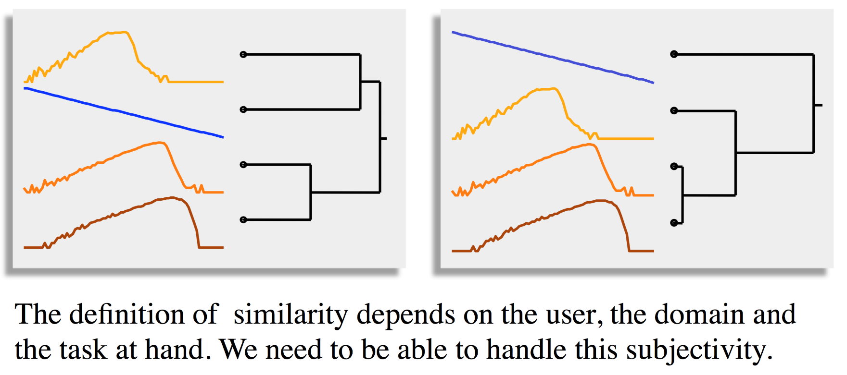

What does D$\text{(}\hat{Y}$,Y) mean?
Measuring Forecasting Quality is depicted with the error measure
„ why?
=> Quality Measurement is a type of similarity/distance measurement:
Comparison of curve of forecasted values with curve of historical data
What is the consequence?

Slide 17
The Ugly Duckling Theorem (UDT) [Watanabe, 1969]
One of the key question in Data Science is similarity
Relevant for every pattern recognition algorithm
(Dis-)similarity is most often Euclidean distance, but thats most often incorrect
UDT states: classification is impossible without some sort of bias

Slide 18
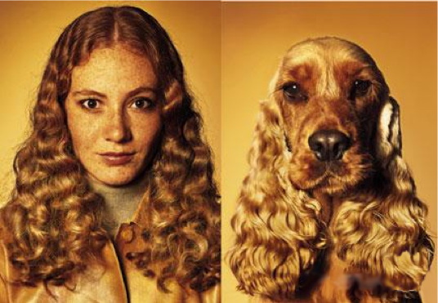
The Ugly Duckling Theorem (UDT) [Watanabe, 1969]
One of the key question in Data Science is similarity
Relevant for every pattern recognition algorithm
(Dis-)similarity is most often Euclidean distance, but thats most often incorrect
UDT states: classification is impossible without some sort of bias
Depends on the features & distance chosen
Example on the right
Similarity is interrelated with the
representation of data
Are this two pictures is similar to each other?

Slide 19
Consequence of UDT
Evaluation of forecasting results is always biased if a quality measure (QM) is seen as a similarity measure between the forecast curve and the test set curve of data [Thrun et al., 2019]
UDT: any two different curves share the same number of properties (c.f. [Watanabe, 1969])
QM should be chosen accordingly to the goal
Select the bias relevant to your problem (e.g. [Thrun et al., 2019])

Slide 20
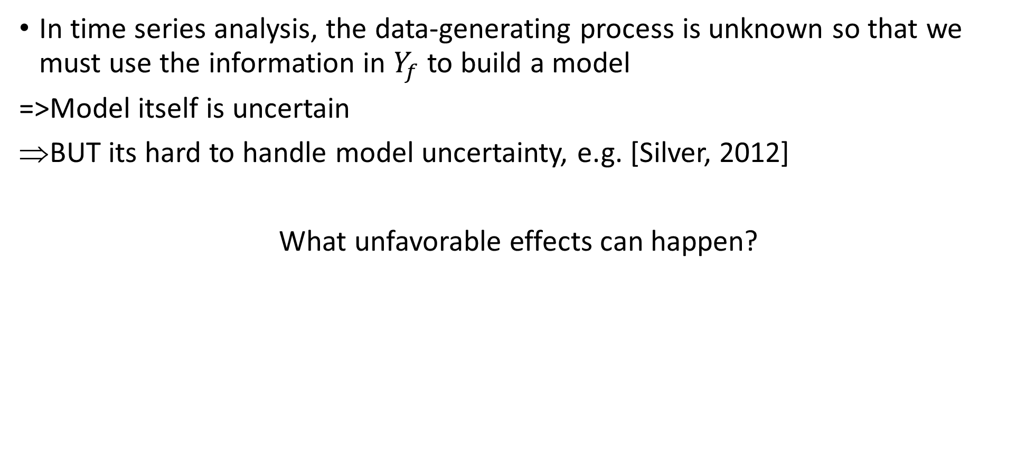
The signal and the noise [Silver, 2012]
In time series analysis, the data-generating process is unknown so that we must use the information in $Y_{f}$ to build a model
=>Model itself is uncertain
BUT its hard to handle model uncertainty, e.g. [Silver, 2012]
What unfavorable effects can happen?

Slide 21

Effects of Uncertainty
Underfitting refers to a model that can neither model the training data nor generalize to new data
-> Knowledge Discovery approaches on residuals and temporal structures
Overfitting refers to a model that learns also noise instead of only learning the signal
-> Should be investigated with statistical approaches using specific cross-validation
-> More likely with nonlinear models like neural networks

Slide 22
Interpretation of Underfitting versus Overfitting
Underfitting ⬄ Model has high bias
Overfitting ⬄ model has a high variance (especially on the test set)

Slide 23
Limiting Uncertainty by “More Learning”?
Uncertainty can lead to either overfitting or underfitting
Can we assume that larger training datasets or more complex models resolve the problem?
E.g. deep learning on large data sets

Slide 24
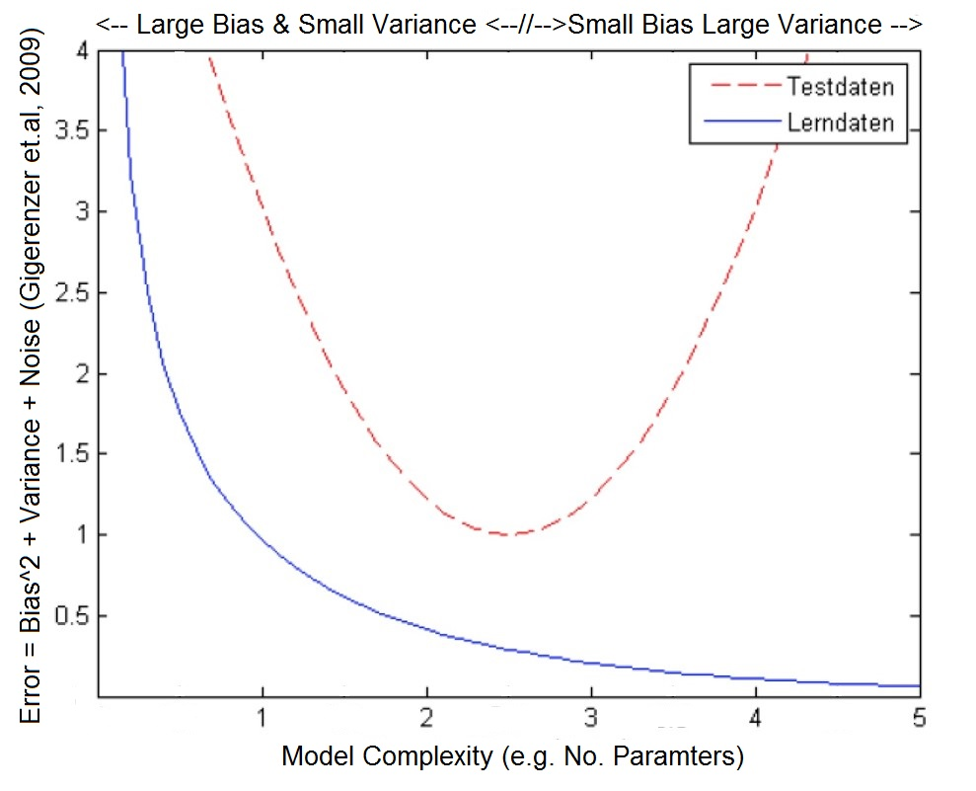
Pitfall of the Learning Behavior of ML Models
The more data the method “learns”, the more complex the model and more precisely the adaptation
However, above a certain limit, the underlying principles are not well mapped, i.e. the test data set is forecasted with large errors
Sources: [Ultsch Lectures; Geman et al., 1992; Gigerenzer/Brighton, 2009; Ben-David et al., 2018]
Learning behavior of forecasting models when comparing test data and learning data

Slide 25
Pitfall of the Learning Behavior of ML Models
The more data the method “learns”, the more complex the model and more precisely the adaptation
However, above a certain limit, the underlying principles are not well mapped, i.e. the test data set is forecasted with large errors
-> Optimal „Approximation of a target concept given a bounded amount of data” (“Learning”) cannot be proven [Ben-David et al., 2018]
Learning behavior of forecasting models when comparing test data and learning data
=> „Optimum unknown“

Slide 26
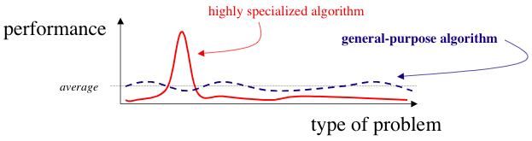
No Free Lunch Theorem (NFL) - [Wolpert, 1996]
Let X Time series of electricity prices should be forecasted, one per region, then
No solution given by an algorithm can be better than any other if the number of problems is high enough
Average is often the chance level

Slide 27
No Free Lunch Theorem (NFL) - [Wolpert, 1996]
Let X Time series of electricity prices should be forecasted, one per region, then
No solution given by an algorithm can be better than any other if the number of problems is high enough
Average is often the chance level
Choose the “right” representation of data meaning that you answer the question:
„What are my objects/smallest units in which I operate“?
Select algorithm(s) problem-specific and adapted to your data representation(e.g. [Thrun et al., 2019])
Requires discussion with domain expert

Slide 28
Summary of Challenges
Underfitting can be restricted with typical knowledge discovery approaches
investigate residuals and their temporal structures
Overfitting can be handled with Crossvalidation
Test-sample bigger than one season (repeating cycle)
At least 100 times for statistical relevance in order to handle uncertainty
The Ugly Duckling Theorem (UDT)
Quality measure (similarity) has to be defined problem-specific
-> communicate with domain expert
No Free Lunch Theorem (NFL)
No algorithm can outperform all others in every application
=> Data preprocessing using knowledge discovery and communication with the domain expert is critical

Slide 29
Benchmarking Various Methods
Premise is that data source (Nord Pool) is the appropriate market providing useful data for forecasting
c.f. Prediction of Quarterly Financial Data of Stocks [Thrun, 2019a])
Lets try to spot the implicit assumption I made
Maybe even spot mistakes I made ☺
-> Benchmarking in Rmarkdown….

Slide 30
Explicit Assumptions are the Key Factors for Success
Well-selected forecasting horizon/interval, data & target feature(s)
Is the appropriate unit: Euro/MWh of hourly time series?
Even if the region lie in Scandinavian countries having other currencies
No systematic change between weekdays (e.g. [Taylor/Letham, 2018]) or day and night (e.g. [Locarek-Junge, 2019]) exist
Does the regional location of time series not result in structural differences?
Contrary example in country-based GDP [Thrun, 2019b]
Overfitting is accounted for well because time interval of test set is large enough (at least one season)
Quality measure with an appropriate bias is chosen
Unambiguous Objective
Proper Data Reprensen-tation
Limited Uncertainty
Choice of Similarity

Slide 31
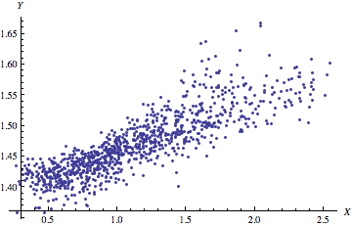
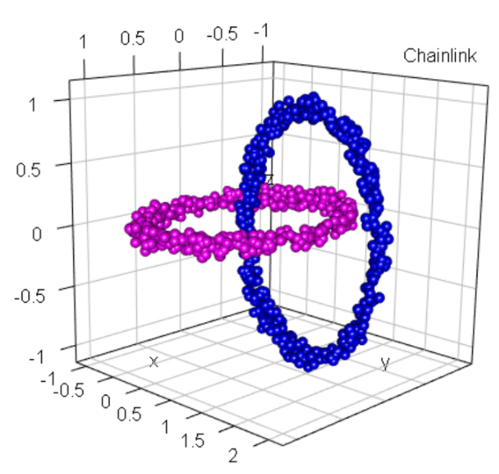
Implicit Assumptions for Working with ANNs
Less complex but „understandable“ ML approaches approaches (like Facebook‘s prophet, [Taylor/Letham, 2018]) failed
Knowledge discovery performed extensively
Structure and quality of the data must be statistically clarified PRIOR to coding
Problem is multivariate
Relevant information is contained in more than one variable
Information is nonlinear and complex interrelated
Causality (cause -> effect)
No other predictors majorly influence the price market significantly (e.g. energy production, hydro reservoirs in Scandinavia, …)
Used predictors are available BEFORE period of forecasting
=> Then, and only then we should use artificial neural networks
Simple Interrelation
Complex Interrelation

Slide 32
Pitfalls for Artificial Neural Networks (ANN)
Too much data can lead to memorization of each data point
Too complex models will model everything leading to complete deterministic worldview
“Which ANN with which architecture is suitable for a given problem remains largely unsolved” [Ultsch Lectures on ANN]
Artificial neural networks usually learn based on errors and are not human-understandable (interpretable)
Learning is self-restricted (no more errors no more optimization)
But one can learn more/better if one uses knowledge and understands the problem (interpretable ML)
Use Ockham's razor to decided between models
Notes:
Wer mit ANN seriös arbeiten will, wende sich an doe European Neural Network Society, e.g. Villmann, Ritter, Ultsch, usw.

Slide 33
Summary
Data Science Projects
Are interdisziplinary –> require team work and communication
Are successfully performed if an domain expert is available
Should only start if they have a clear objective
Forecasting has the following principal challenges
Problem-specific preprocessing is the key to success and requires knowledge discovery
Uncertainty can lead to either overfitting or underfitting
Underfitting has to be investigated with methods of knowledge discovery
Overfitting should be investigated statistical approaches
Biases of forecasting methods and quality measure have to be exploited depending on the structures/patterns of the time series relevant to the problem

Slide 34
Sources
Watanabe, S.: Knowing and Guessing: A Quantitative Study of Inference and Information, New York, USA, John Wiley & Sons Inc., ISBN: 9780471921301, 1969.
Wolpert, D. H.: The lack of a priori distinctions between learning algorithms, Neural Computation, Vol. 8(7), pp. 1341-1390. 1996.
Geman, S., Bienenstock, E., & Doursat, R.: Neural networks and the bias/variance dilemma, Neural Computation, Vol. 4(1), pp. 1-58. 1992.
Gigerenzer, G., & Brighton, H.: Homo heuristicus: Why biased minds make better inferences, Topics in cognitive science, Vol. 1(1), pp. 107-143. 2009.
Silver, Nate: The signal and the noise: why so many predictions fail--but some don't. Penguin, 2012.
Locarek-Junge, H. : A Night in the Stock Exchange. What Happens Between Dusk and Dawn to the WIG20 Index?, Proc. 5th German-Polish Symposium on Data Analysis and Applications (GPSDAA), p. 3, Germany, 2019.
Taylor, S. J., & Letham, B.: Forecasting at scale, The American Statistician, Vol. 72(1), pp. 37-45. 2018.
Thrun, M. C.: Knowledge Discovery in Quarterly Financial Data of Stocks Based on the Prime Standard using a Hybrid of a Swarm with SOM, in Verleysen, M. (Ed.), European Symposium on Artificial Neural Networks, Computational Intelligence and Machine Learning (ESANN), Vol. 27, pp. 397-402, Ciaco, 978-287-587-065-0, Bruges, Belgium, 2019a.
Thrun, M. C.: Cluster Analysis of Per Capita Gross Domestic Products, Entrepreneurial Business and Economics Review (EBER), Vol. 7(1), pp. 217-231. doi 10.15678/EBER.2019.070113, 2019b.
Thrun, M. C., Märte, J., Böhme, P., & Gehlert, T.: Applying Two Theorems of Machine Learning to the Forecasting of Biweekly Arrivals at a Call Center, Proc. European Conference on Data Analysis (ECDA), pp. 36, Bayreuth, Germany, 2019.
Behnisch, M., Ultsch, A.: Knowledge Discovery in Spatial Planning Data - A Concept for Cluster Understanding, in: Helbich, M., Arsanjani, J. J., Leitner, M. (eds.): Computational Approaches for Urban Environments, in: Gatrell, J.D., Jensen, R.R.: Geotechnologies and the Environment Series, Vol, 13, Springer, Berlin, pp. 49-75, 2015.
Ultsch Lectures: „Neuronale Netze“, Lehrstuhl Neuroinformatik und Künstliche Intelligenz, Universität Marburg.
Anastasiadis, A. D., Magoulas, G. D., & Vrahatis, M. N.: New globally convergent training scheme based on the resilient propagation algorithm, Neurocomputing, Vol. 64, pp. 253-270. 2005.
Huang, G.-B., Wang, D. H., & Lan, Y.: Extreme learning machines: a survey, International journal of machine learning and cybernetics, Vol. 2(2), pp. 107-122. 2011.
Huang, G.-B., Zhu, Q.-Y., & Siew, C.-K.: Extreme learning machine: theory and applications, Neurocomputing, Vol. 70(1-3), pp. 489-501. 2006
Ben-David, S., Hrubeš, P., Moran, S., Shpilka, A., & Yehudayoff, A.: Learnability can be undecidable, Nature Machine Intelligence, Vol. 1(1), pp. 44. 2019.

Slide 35
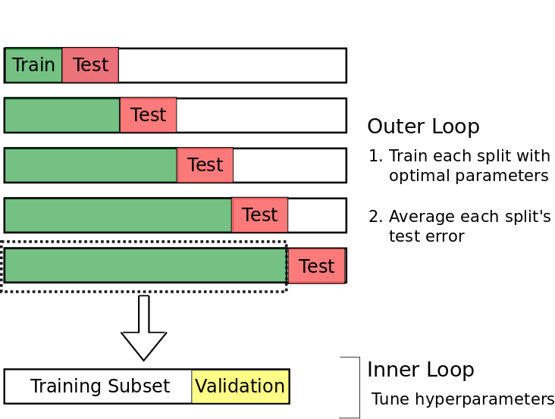
Excurse: Nested Cross-validation
Nested Cross-validation can account for overfitting in complex models

Slide 36
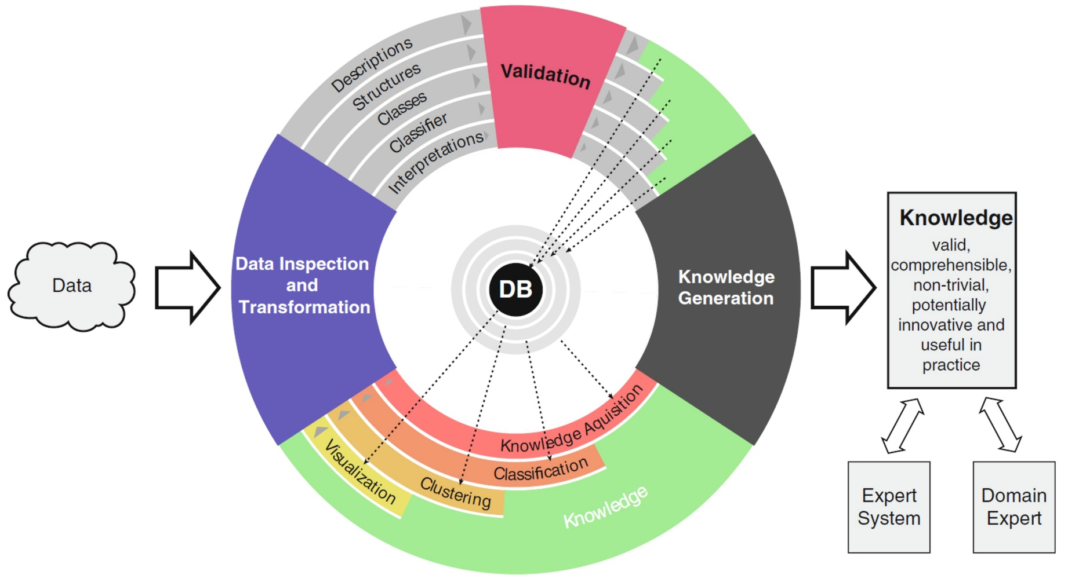
Excurs: Knowledge Discovery
Descriptions: Modeling the distribution of each variable separately
Structures: Finding structures in high-dimensional space
Classes: Finding intrinsic groups, called clusters, in a data set
Classifier: Symbolic classifiers to assist human skills of comprehension
Interpretations: Human understanding of clusters
Source: [Ultsch/Behnisch, 2015]

Slide 37
Key Factors for Success in Data Science
1. Unambiguous Objective
2. Proper Data Reprensentation
3. Limited Uncertainty
4. Choice of Similarity
In Forecasting: Well-selected forecasting horizon/interval, data & target feature(s) and algorithms (interpretable ML vs ANN)
Choice of appropriate resolution and units/objects
For example is there a systematic change between weekdays (e.g. [Taylor/Letham, 2018]) or day and night (e.g. [Locarek-Junge, 2019])
=> Disaggregate one time series into components
Does the regional location of time series has structural differences?
Perform cluster analysis (e.g. [Thrun, 2019b])
Can problems be summarized? ->Aggregate multivariate problem to univariate time series (e.g. [Thrun et al., 2019]))
Preprocessing (e.g. detrending, standardization,…)
Overfitting is accounted for well if time interval of test set is at least one season with a statistically large enough sample (>100 cases)
Quality measure with an appropriate bias is chosen
Algorithm with appropriate bias is selected

Slide 38
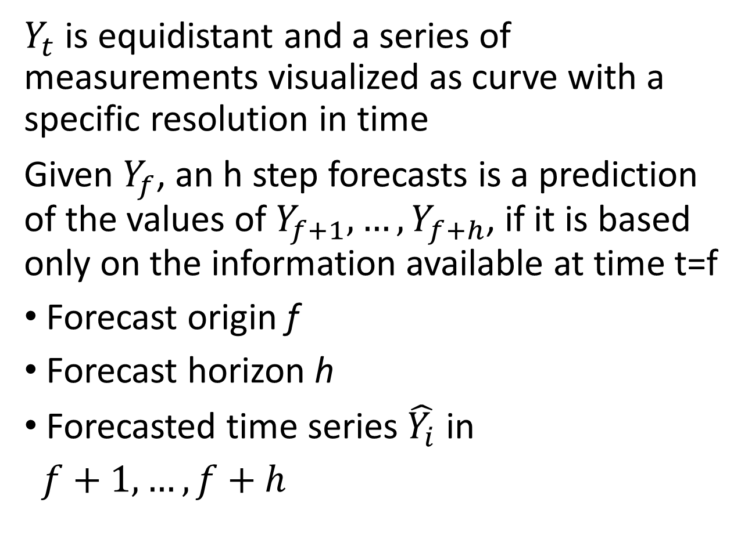
Recapitulation: Forecasting
$Y_{t}$ is equidistant and a series of measurements visualized as curve with a specific resolution in time
Given $Y_{f}$, an h step forecasts is a prediction of the values of $Y_{f+1},{…,Y}_{f+h}$, if it is based only on the information available at time t=f
Forecast origin f
Forecast horizon h
Forecasted time series $\hat{Y_{i}}$ in
$f+1,…,f+h$

Slide 39
Effects of Uncertainty
Underfitting refers to a model that can neither model the training data nor generalize to new data
-> Knowledge Discovery approaches on residuals and temporal structures
Overfitting refers to a model that learns also noise instead of only learning the signal
-> Should be investigated with statistical approaches using specific cross-validation procedure
-> More likely with nonlinear models like neural networks

Slide 40
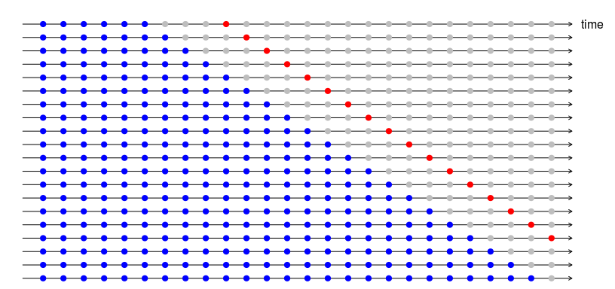
Best Practice: Cross-Validation
Cross-validation
Use more than one round of out-of-sample forecasting
Account for temporal structures by rolling forecast
Multi-step forecasting horizon with unit point h in red
See coding in Rmarkdown for details
Blue: training set
Grey: test set (sample not used in model building)
Red: forecast horizon

Slide 41
The Ugly Duckling Theorem (UDT) [Watanabe, 1969]
One of the key question in Data Science is similarity
Relevant for every pattern recognition algorithm
(Dis-)similarity is most often Euclidean distance, but thats most often incorrect
UDT states: classification is impossible without some sort of bias
Depends on the features chosen
Similarity depends on the
representation of data
=> Quality Measurement can be regarded as a similarity measure [Thrun et al., 2019]
Are this two pictures is similar to each other?

Slide 42
Pitfall of the Learning Behavior of ML Models
Bias of algorithm is reduced and variance is increased in relation to model complexity
As more and more parameters are added to a model, the complexity of the model rises and variance becomes our primary concern while bias steadily falls
However, above a certain generally unknown limit the underlying principles are not well mapped, i.e. the test data set is forecasted with large errors
1
3
2
Sources: [Ultsch Lectures; Geman et al., 1992; Gigerenzer/Brighton, 2009; Ben-David et al., 2018]

Slide 43
No Free Lunch Theorem (NFL) - [Wolpert, 1996]
Let X Time series of electricity prices should be forecasted, one per region, then
No solution given by an algorithm can be better than any other if the number of problems is high enough
Choose the “right” representation of data meaning that you answer the question:
„What are my objects/smallest units in which I operate“?
Select algorithm(s) problem-specific and adapted to your data representation(e.g. [Thrun et al., 2019])
Requires discussion with domain expert
Average is often the chance level

Slide 44
Implicit Assumptions for Working with ANNs
Simple Interrelation
Less complex but „understandable“ ML approaches failed
E.g. Facebook‘s prophet, [Taylor/Letham, 2018]
Knowledge discovery was performed extensively
Structure and quality of the data were statistically clarified PRIOR to coding
Problem is multivariate
Relevant information is contained in more than one time series
Information is nonlinear and complex interrelated
Causality (cause -> effect)
No other predictors majorly influences the price market significantly (e.g. energy production, hydro reservoirs in Scandinavia, …)
Used predictors are available BEFORE period of forecasting
=> Then, and only then we should use artificial neural networks
Complex Interrelation

